Slide 1
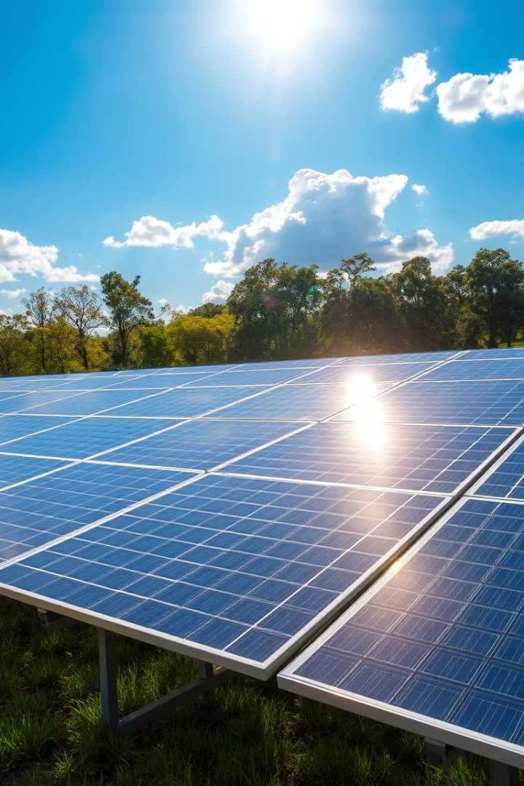
Solar Tracking System for Optimal Solar Panel Performance
TEAM DETAILS:
J. Vishwanath Reddy (Team Leader) - Roll Number: B23IN040
S. Rishitha - Roll Number: B23IN018
A. Supritha - Roll Number: B23IN010
K. Rahul - Roll Number: B23IN045
P. Srijitha - Roll Number: B23IN012
N. Thrushitha - Roll Number: B23IN036
N. Goutham - Roll Number: B23IN009

Slide 2


Introduction
1
2
3
Solar Energy
Current Issue
Proposed Solution
The most abundant renewable resource.
Static solar panels only capture optimal energy for limited hours.
A solar tracking system that dynamically aligns panels with the sun.

Slide 3

Problem Statement
Challenges
Impact
Static solar panels underperform.
Limited solar power utilization and increased dependency on non-renewable energy.
Lack of scalable tracking systems.
High energy consumption .

Slide 4
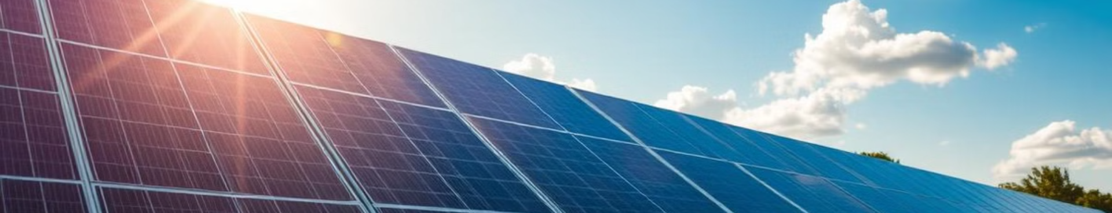

Objectives
1
Increase Efficiency
2
Mechanical- electric rotation
Ensure panels track the sun for maximum exposure.
Use Mechanical methods and Electrified methods
for rotation of panels.
3
Affordability
4
Scalability
Prioritize low-cost materials suitable for rural applications.
Adapt the system for both small-scale and large-scale installations.

Slide 5


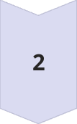

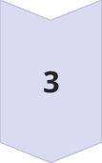

Methodology (Algorithm)
Repeat
Start
Continuously monitor and adjust until sunset.
Initialize the system and set the panel’s default
Position at east
Monitor Sunlight
Use sensors to detect sunlight intensity from
Multiple directions.
Stops at night
Automatically turns off rotating when there is no
sunlight.
Adjust Position
Calculate the optimal angle and move the panel
accordingly.

Slide 6
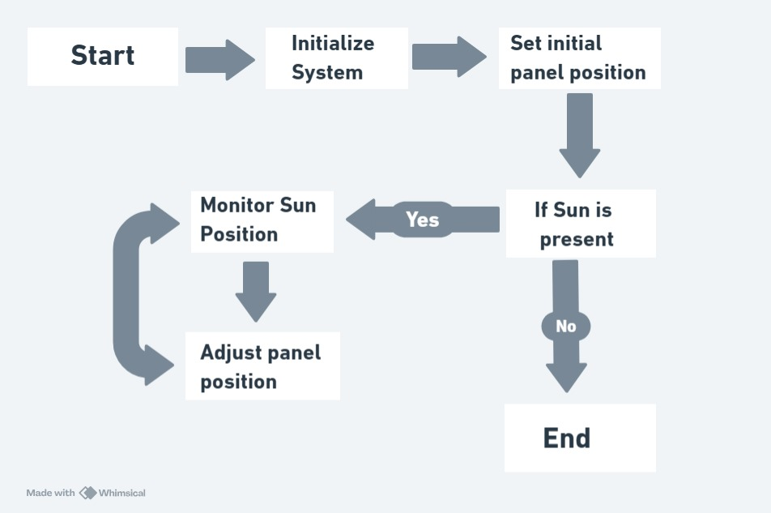

Methodology (Flowchart)

Slide 7
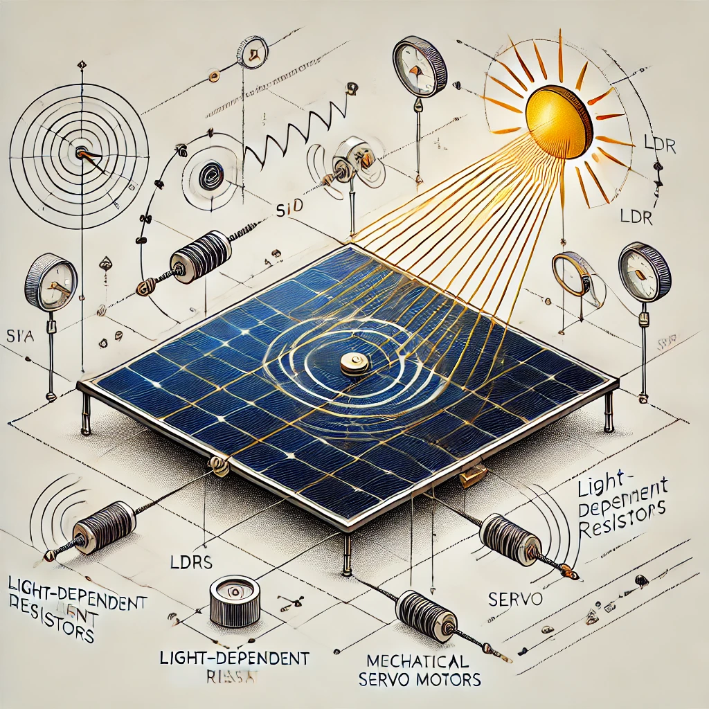




Methodology : Block Diagram
Input
Sunlight intensity data is received from the LDR sensors, providing real-time environmental information.
Processing
The Arduino microcontroller processes the data, calculating the ideal angle for the panel to maximize solar energy capture.
Output
The controller sends commands to the servo motor instructing it to adjust the panel's orientation accordingly.

Slide 8
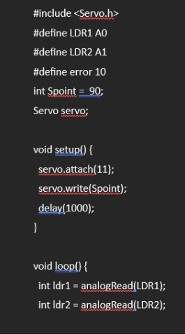
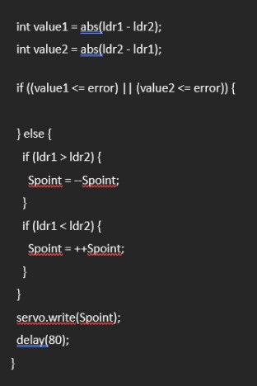
CODE :

Slide 9
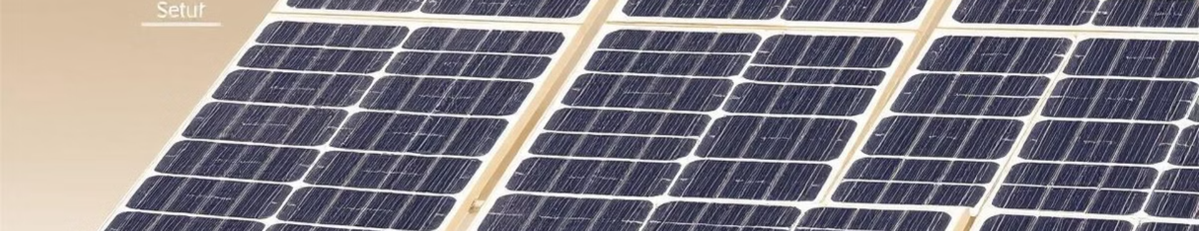

Innovations in the Approach
1
Energy Optimization
2
Night Time Shutdown
3
Scalability
Real-time adjustments based on sunlight intensity, enhancing overall energy efficiency.
There will be no scope of rotation whenever there is no sunlight , thus panels get break for working again efficiently.
Modular design allows for easy expansion to large solar farms, accommodating diverse energy needs.

Slide 10
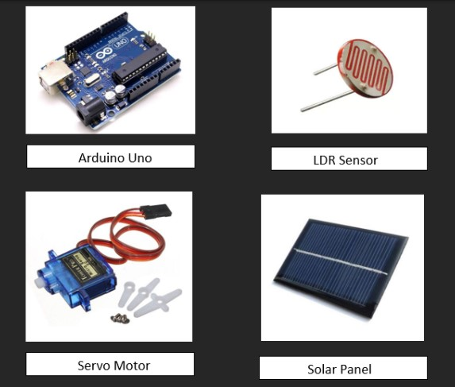





Experimental Work - Components
LDRs
Detect sunlight intensity with high precision.
Arduino
Processes data and executes movement commands.
Servo Motor
Enables smooth, precise panel rotation.
Solar Panel Model
For setting up the working model.

Slide 11
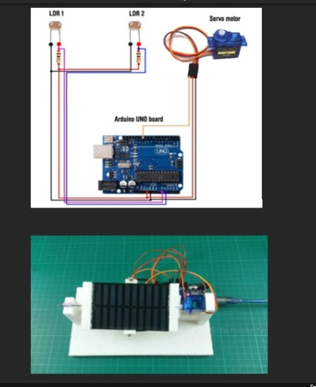
Experimental Work – Assembly Process
1
Step 1
Connect LDRs to Arduino for real-time sunlight detection.
2
Step 2
Mount the servo motor on the frame for panel movement.
3
Step 3
Configure the algorithm in Arduino for dynamic tracking.
4
Step 4
Test and calibrate the system for optimal performance.

Slide 12

Results and Discussion: Performance
Energy Output
Hybrid Rotation
The tracking system demonstrates a remarkable 30-40% improvement in energy output compared to static panels, significantly boosting energy harvesting.
Combination of Mechanical and Electrified Rotation enhances improved use of solar panel efficiently.

Slide 13

Results and Discussion: Graphs and Tables
Metric
Before Implementation
After Implementation
Energy Output
100 kWh
130-140 kWh
Power Consumption
5 kWh
2 kWh

Slide 14
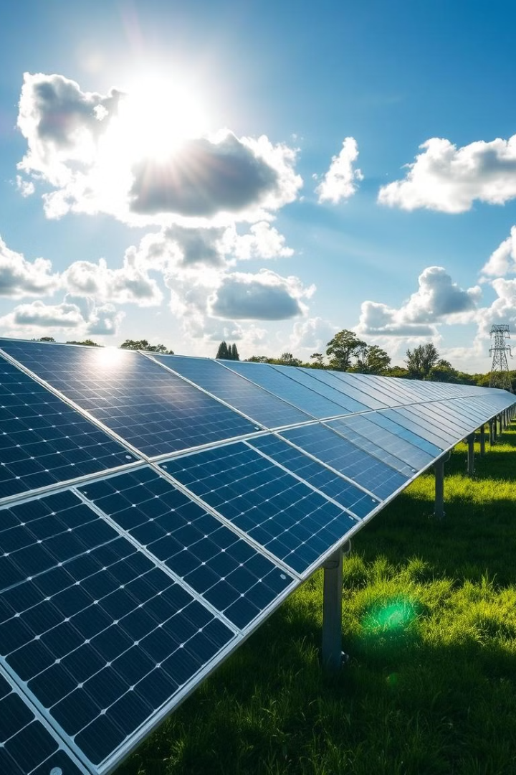
Conclusion
This innovative solar tracking system offers an efficient solution for maximizing solar energy utilization. Its modular design, energy-efficient algorithms, and ease of use make it suitable for both small-scale and large-scale installations.

Slide 15


References :
RenewableEnergyWorld.com: Non-Electrical Solar Tracking Systems.
Renewable Energy Systems Journal: Performance Comparison of Fixed and Dynamic Panels.
International Journal of Energy Science and Engineering: Innovative Solar Tracking for Rural Areas.
4. ChatGPT
5.YouTube

Slide 16

THANK YOU

